Slide 1
Putting loops into practice: Illumina data cleaning
1. Illumina data format
2. Illumina data quality assessment
3. Illumina data quality filtering

Slide 2
Paired-end sequencing, paired-end data
Do you remember how paired reads are produced?
What type of data should we obtain? How many files per sample?

Slide 3
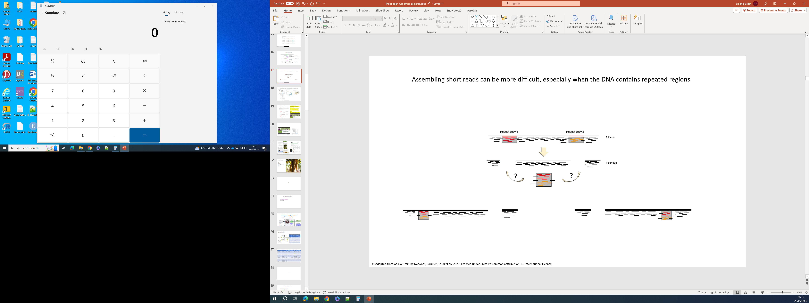
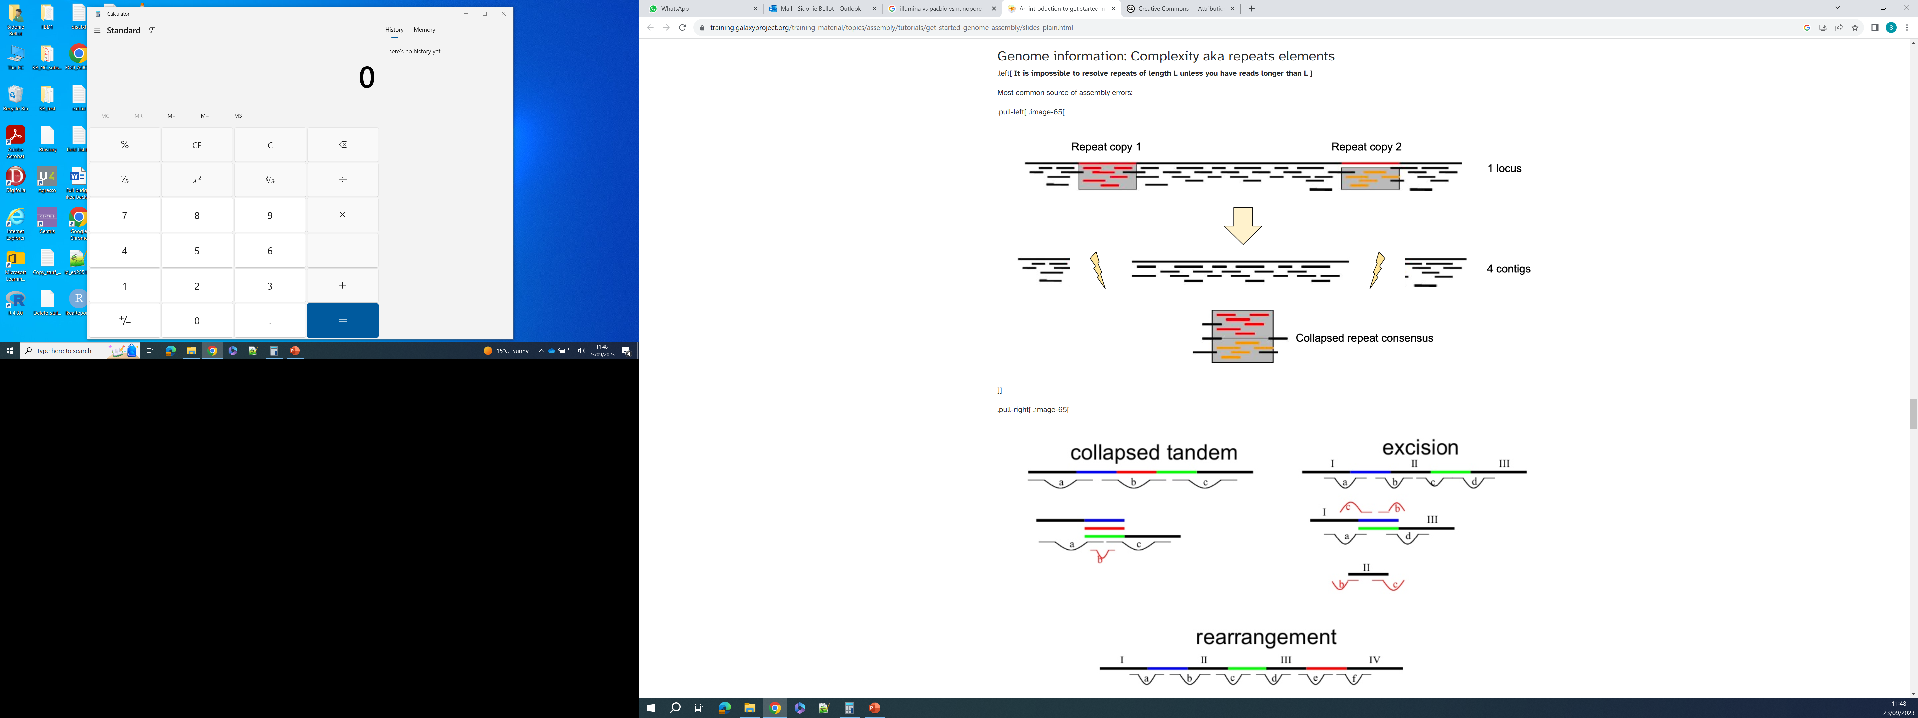
Paired-end sequencing can help solving assemblies of complex regions
Paired-end sequencing
DNA fragment being sequenced
500 bp in average
We know that read 1 and read 2 come from a same DNA fragment
And we know the average length of the DNA fragments
We know that the distance between read 1 and read 2
cannot be more than the DNA fragment size:
Read 1 and read 2 cannot be more than ~500 bp apart
read 1
forward read
150 bp
read 2
reverse read
150 bp
More than 500 bp between read 1 and read 2: this assembly is wrong!
read 1
read 2
This is the correct assembly
© Adapted from Galaxy Training Network, Cormier, Leroi et al., 2023, licensed under Creative Commons Attribution 4.0 International License

Slide 4
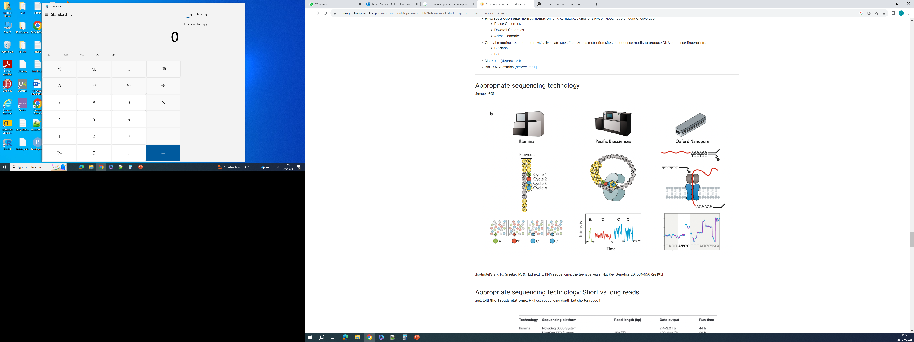
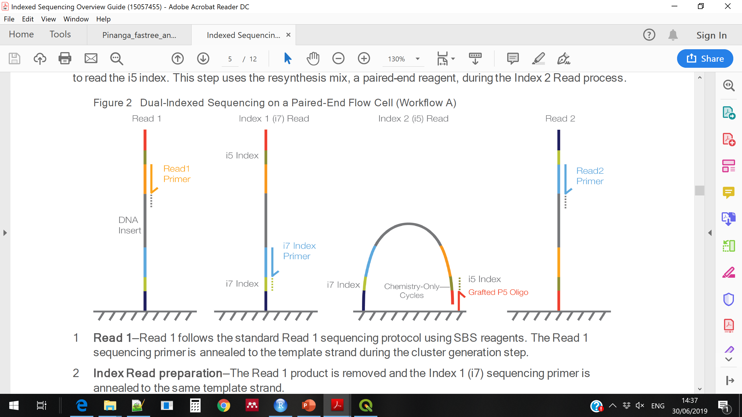
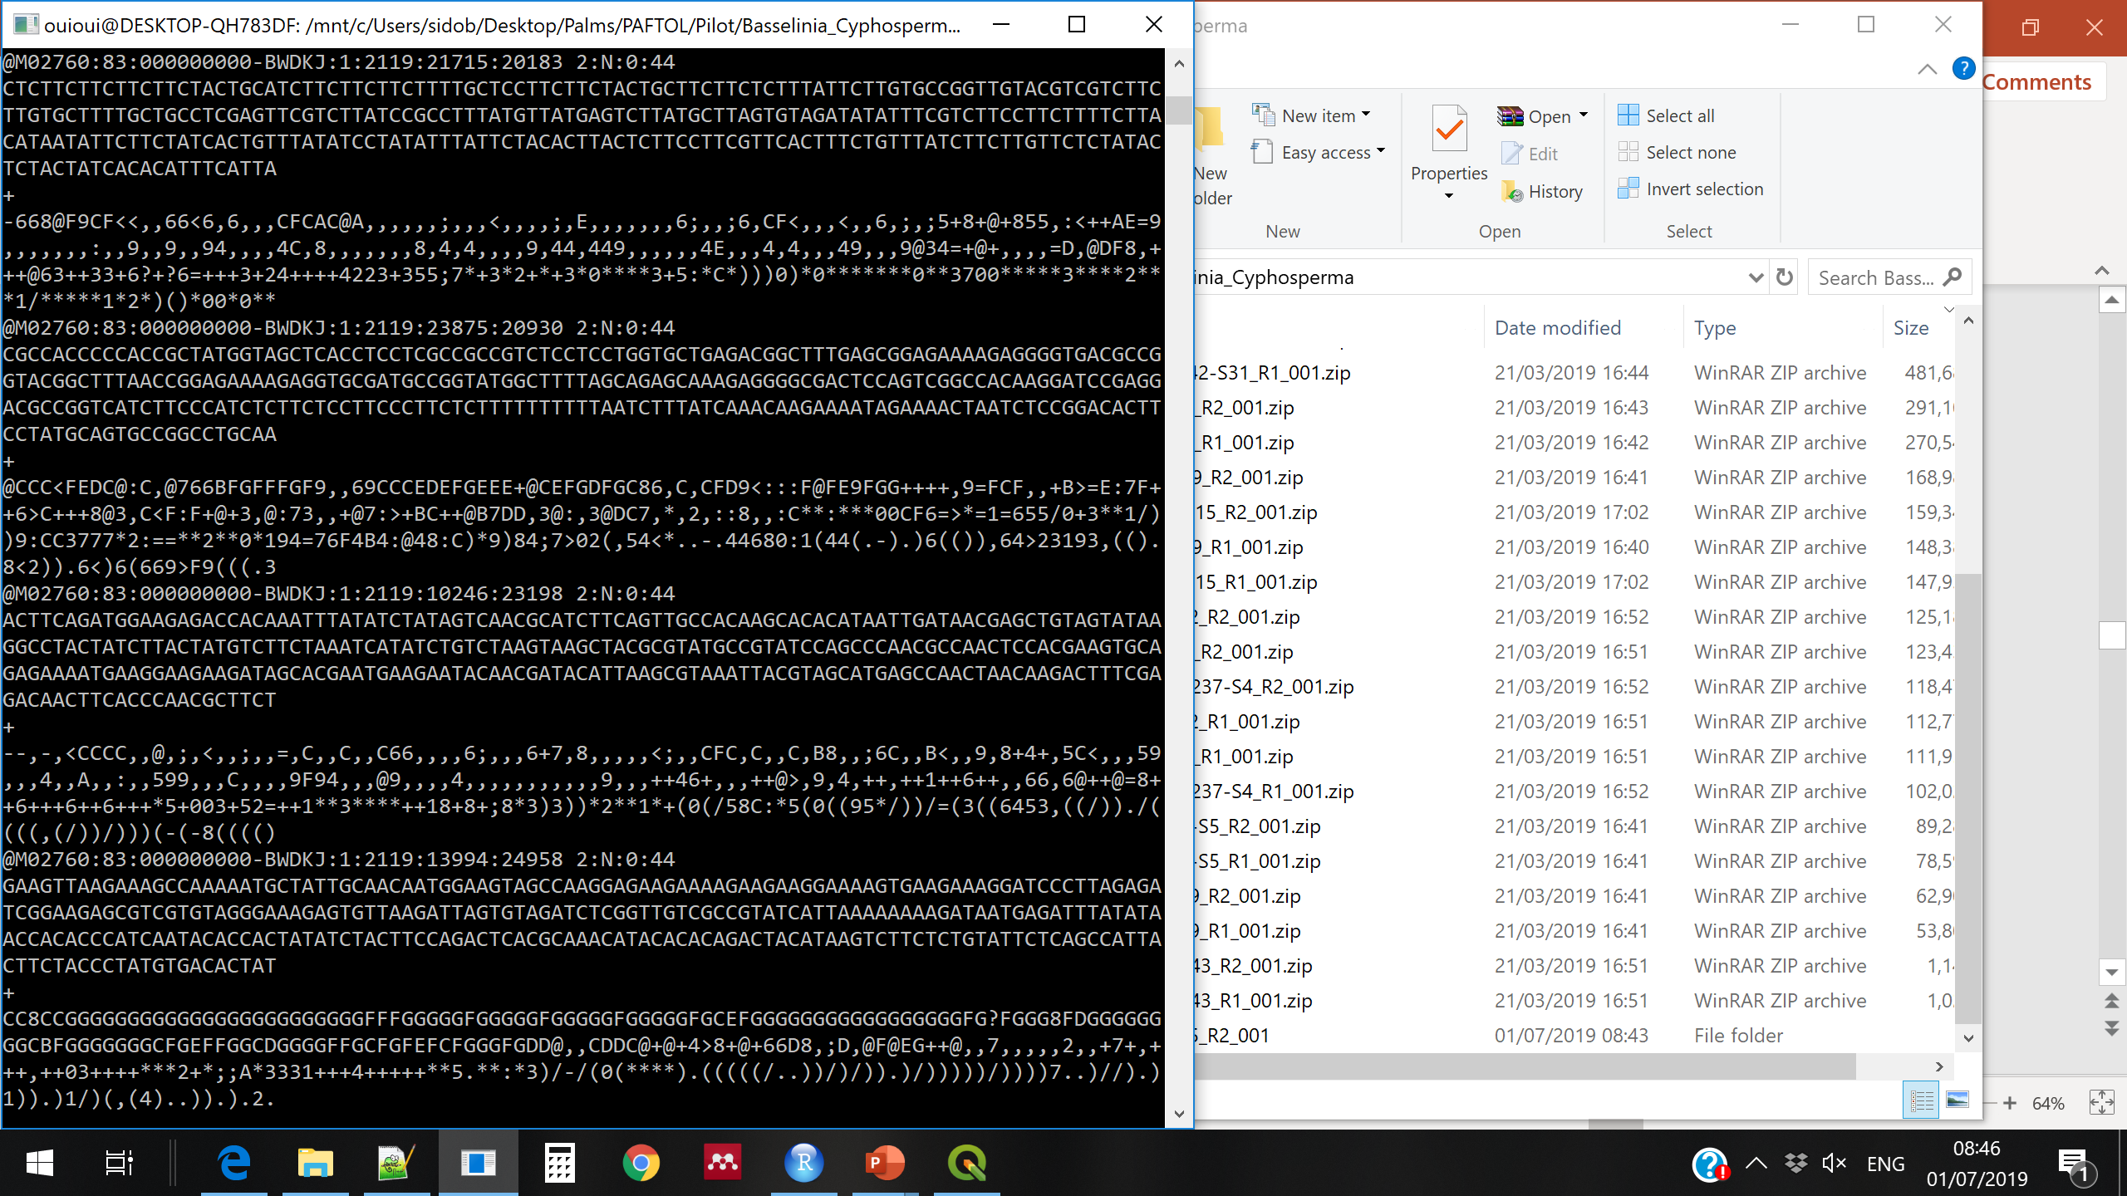
Illumina sequencing
(a bit different depending on the machine)
Millions of DNA fragments are attached to a “flow cell”
For each fragment, the complementary strand is synthesised
And the added nucleotides are “read” in real time
Producing a file with the DNA read and reading quality for each nucleotide →
© Adapted from Galaxy Training Network, Cormier, Leroi et al., 2023, licensed under Creative Commons Attribution 4.0 International License

Slide 5
Paired-end sequencing, paired-end data
Do you remember how paired reads are produced?
What type of data should we obtain? How many files per sample?

Slide 6
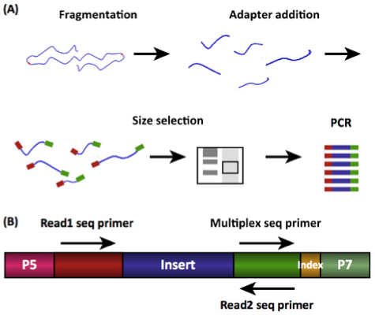
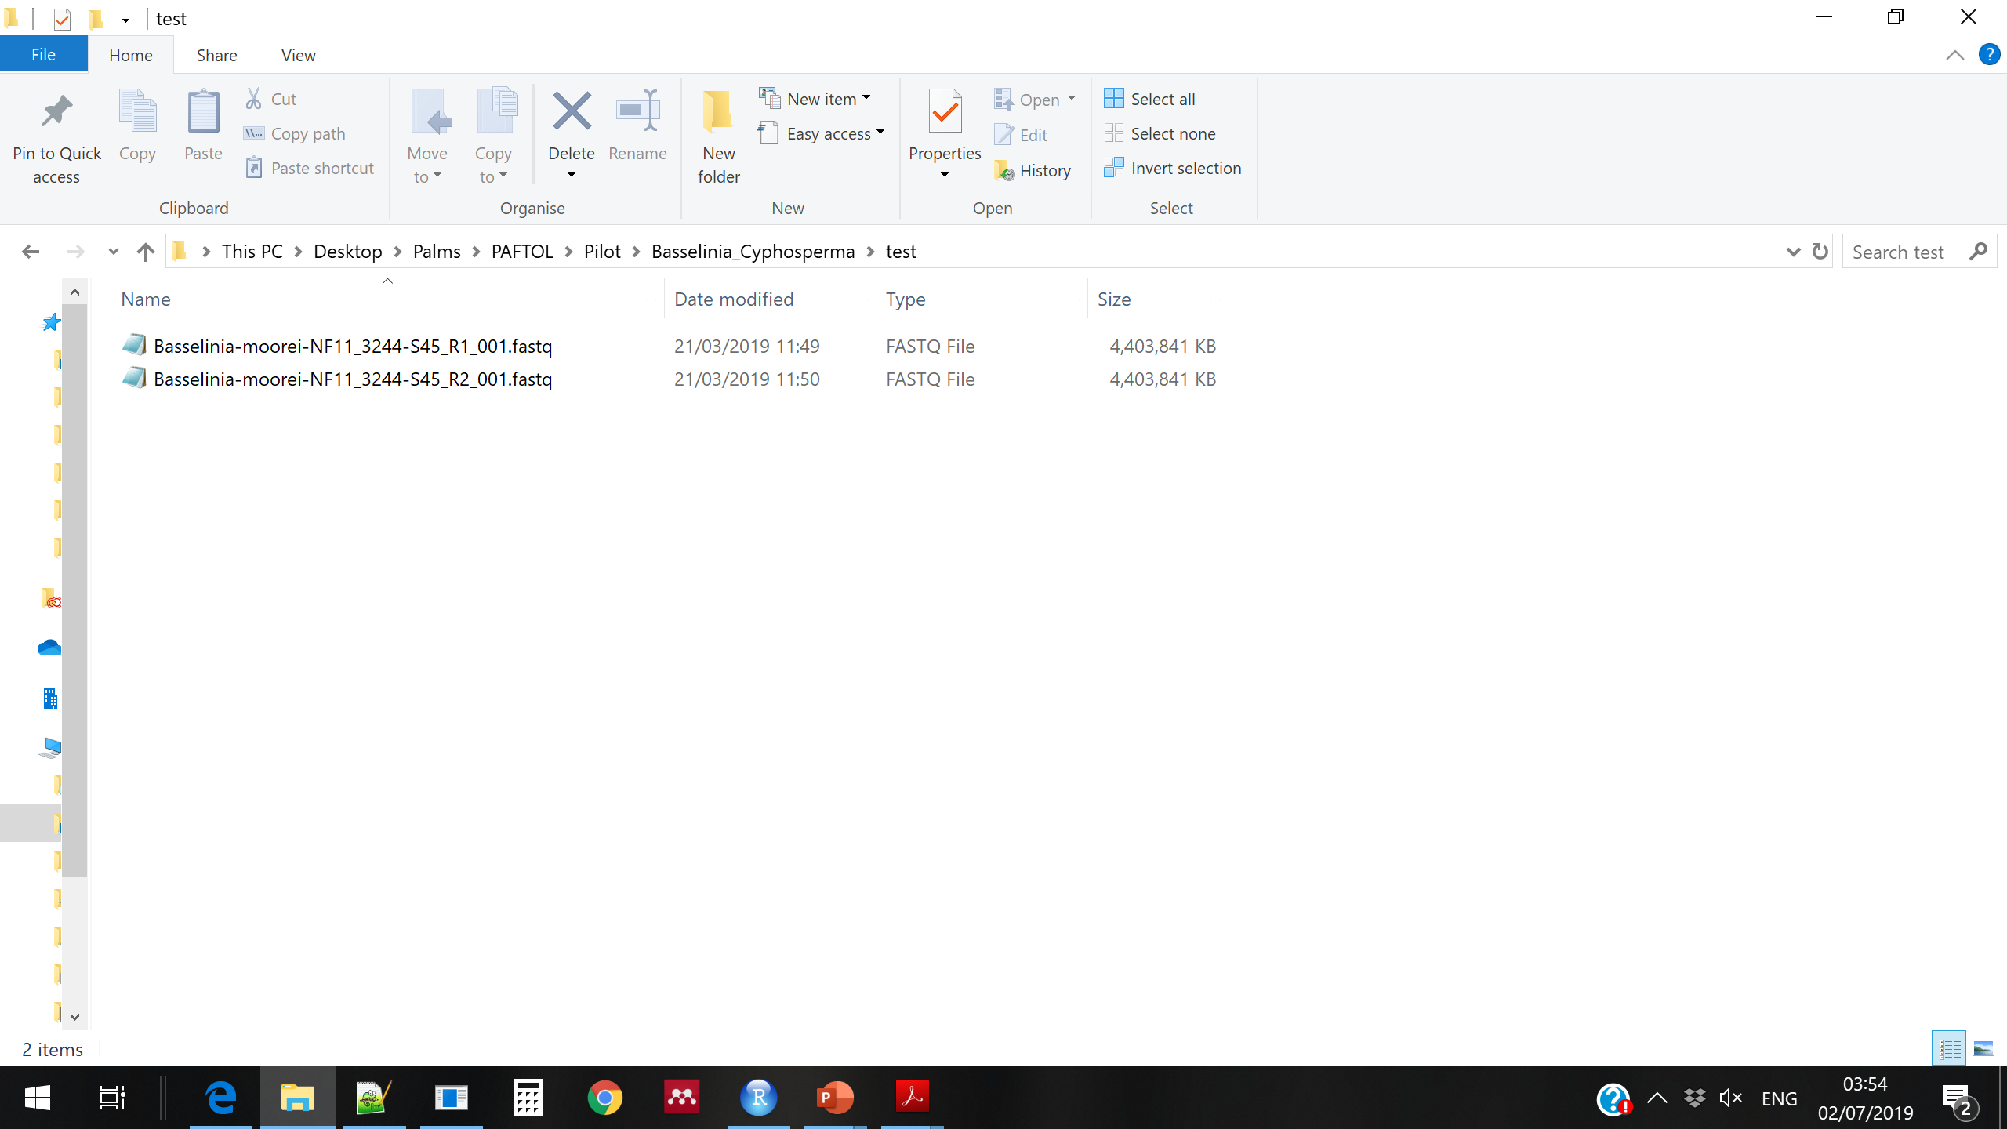
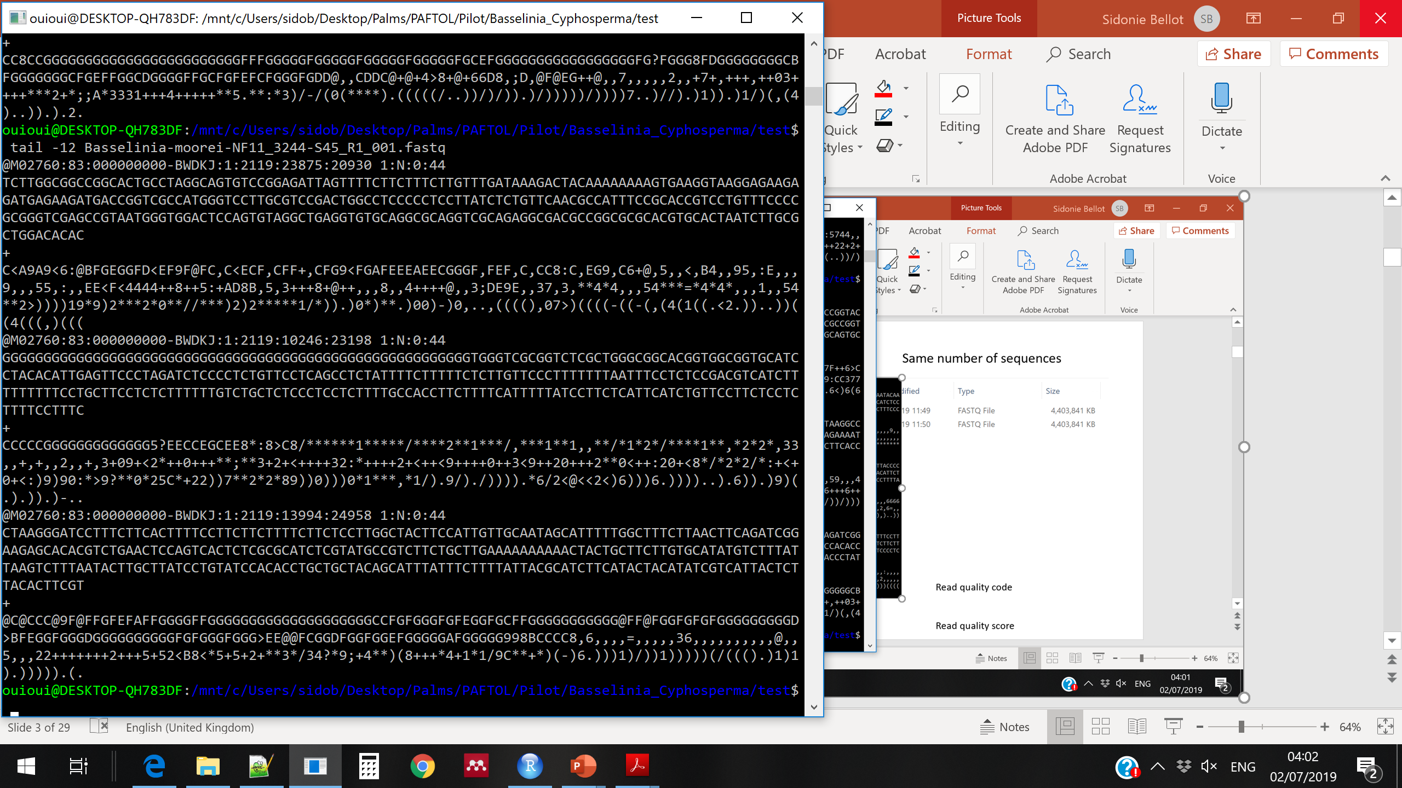
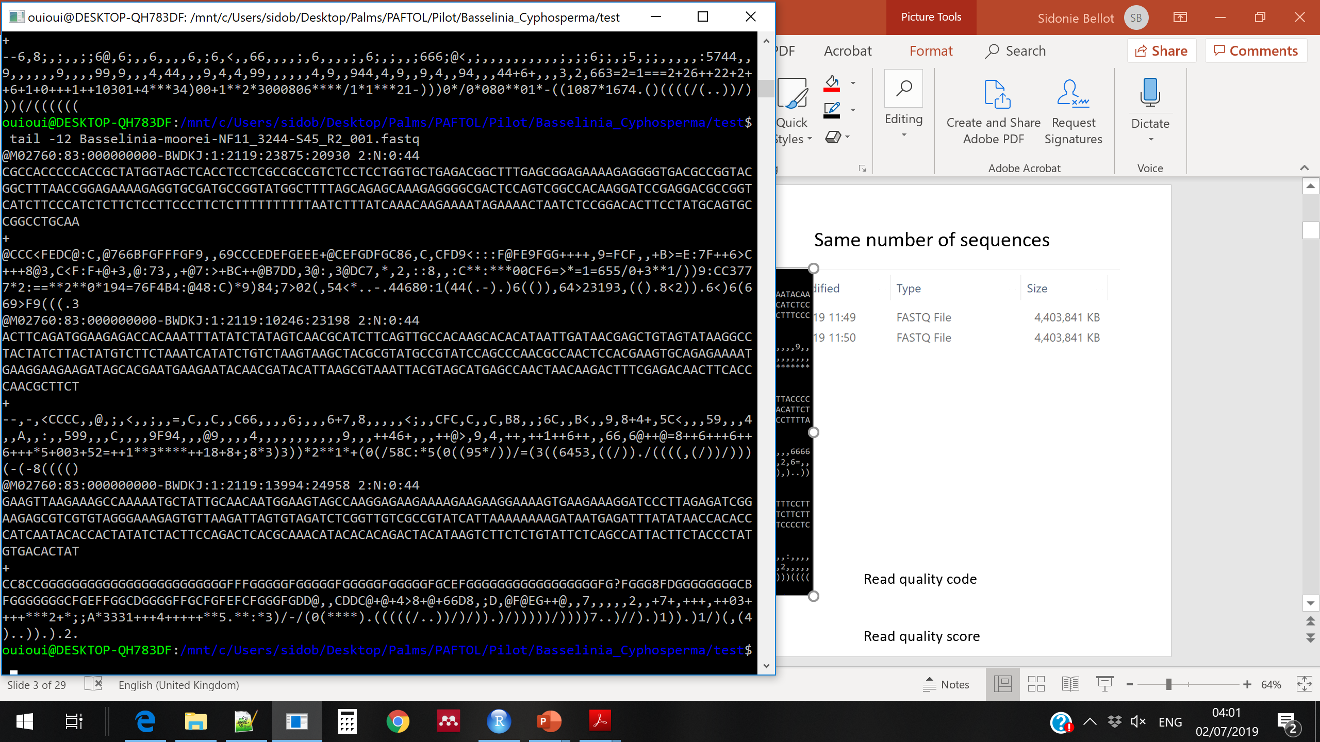
R1
Paired-end data: 2 reads (R1 and R2) from each DNA fragment
→ 2 files: *R1.fastq and *R2.fastq, same number of sequences
R2
R1
R2

Slide 7

Exercise: understand your data
How many samples were sequenced in your toy dataset?
Print to the screen the first 12 lines of the R1 and R2 files for one sample

Slide 8

Solutions: understand your data
How many samples were sequenced in your toy dataset?
Print to the screen the first 12 lines of the R1 and R2 files for one sample
head -12 sample1_R1.fastq
head -12 sample1_R2.fastq
or
head -12 sample1_*.fastq

Slide 9
Illumina data format and quality encoding
Fasta format: 2 lines per read
>Read name
Read sequence
>read35467
ATCGTGATGTACCAGTTGACCATGGACGTCAGTCCATTGACCT
Fastq format: 4 lines per read
Read name
Read sequence
Read name or “+”
Read quality

Slide 10
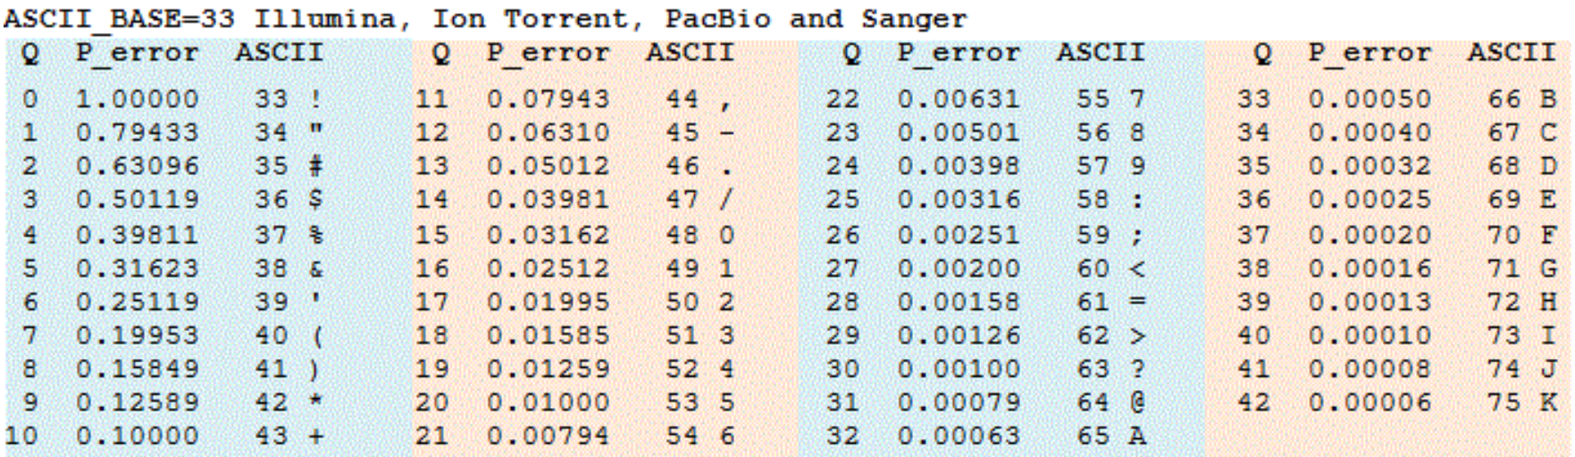
Illumina data format and quality encoding
Fasta format: 2 lines per read
>Read name
Read sequence
>read35467
ATCGTGATGTACCAGTTGACCATGGACGTCAGTCCATTGACCT
Fastq format: 4 lines per read
Read name
Read sequence
Read name or “+”
Read quality
Read quality is encoded with ASCII characters, where each quality code corresponds to a phred score Q
https://drive5.com/usearch/manual/quality_score.html

Slide 11
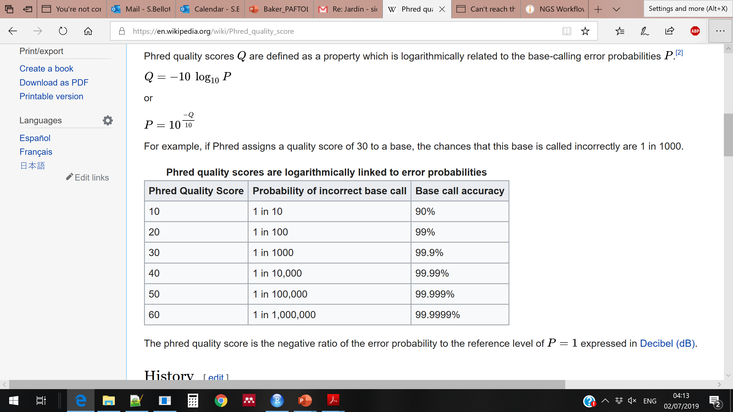
Illumina data format and quality encoding
Phred score Q:
Fasta format: 2 lines per read
>Read name
Read sequence
>read35467
ATCGTGATGTACCAGTTGACCATGGACGTCAGTCCATTGACCT
Fastq format: 4 lines per read
Read name
Read sequence
Read name or “+”
Read quality
P: probability of erroneous base call
Read quality is encoded with ASCII characters, where each quality code corresponds to a phred score Q
Wikipedia
https://drive5.com/usearch/manual/quality_score.html

Slide 12
Exercise: understand the quality codes
Count the number of reads obtained for one of your samples
What is the quality score of the last base of the first forward (R1) read of your first sample?
What is the corresponding probability that the base is wrong?

Slide 13
Solutions: understand the quality codes
Count the number of reads obtained for one of your samples
wc -l sample1_R2.fastq and divide by 4
+
wc -l sample1_R2.fastq and divide by 4
What is the quality score of the last base of the first forward (R1) read of your first sample?
head sample1_R1.fastq and look at the last symbol of the 4th line
What is the corresponding probability that the base is wrong?
Look for the symbol in the table

Slide 14
https://drive5.com/usearch/manual/quality_score.html
Low quality bases will need to be removed from the read extremities

Slide 15
Adapter sequences in the data
Read 1: 150 bp
100 bp
Adapter
Adapter
Read 2: 150 bp
Read 1:
Genuine DNA sequences
Adapter sequences to remove before further analyses
Read 2:
100 bp
50 bp
If the insert is shorter than the read length, the data will contain adapter sequences at the end of the reads.
They need to be removed before further analysis

Slide 16
Exercise: make a list of your samples
Use a for loop to create a list of sample names, based on the file names
For instance, if you have two samples, each with two files, such as:
Sample1_R1.fastq
Sample1_R2.fastq
Sample2_R1.fastq
Sample2_R2.fastq
Your list should contain:
Sample1
Sample2
Tips:
Use a for loop and wild cards
Check the previous slides to remember how to make a loop
Drawing the looping process and the expected output may help you

Slide 17
Solution: make a list of your samples
Use a for loop to create a list of sample names, based on the file names
For instance, if you have two samples, each with two files, such as:
Sample1_R1.fastq
Sample1_R2.fastq
Sample2_R1.fastq
Sample2_R2.fastq
Your list should contain:
Sample1
Sample2
for f in *_R1.fastq; do (echo ${f/_R1.fastq} >> sample_names.txt); done

Slide 18
Exercise: move each file to a directory
Use a for loop to make one directory per sample
Then use another loop to move each file to the directory of its sample
Then use another loop to bring back the files to the main directory
!
Be careful when using the mv command as you may rename your files by mistake. Check the output every time you try, and make first a back-up of the files.

Slide 19
Solution: move each file to a directory
Use a for loop to make one directory per sample
Then use another loop to move each file to the directory of its sample
Then use another loop to bring back the files to the main directory
for f in *R1.fastq; do (mkdir ${f/_R1.fastq} ); done
for f in *.fastq; do (mv $f ${f/_R*.fastq} ); done
for d in */ ; do (mv $d/* .); done

Slide 20
Exercise: create multiple outputs from a loop action
Use a for loop so that, for each data file, two new files are created
For instance, for Sample_1.txt, the loop should create:
- a file called Sample_1_output1.txt
- a file called Sample_1_output2.txt

Slide 21
Exercise: create multiple outputs from a loop action
Use a for loop so that, for each data file, two new files are created
For instance, for Sample_1.txt, the loop should create:
- a file called Sample_1_output1.txt
- a file called Sample_1_output2.txt
for f in *.fastq; do ( touch ${f/.fastq}_output1.fastq && touch ${f/.fastq}_output2.fastq ) ; done

Slide 22
Exercise: create multiple outputs from a loop action on multiple inputs
For each sample, print the first 10 lines of the R1 file in a new file, and the first 10 lines of the R2 file in a different new file
(use a for loop)

Slide 23
Exercise: create multiple outputs from a loop action on multiple inputs
For each sample, print the first 10 lines of the R1 file in a new file, and the first 10 lines of the R2 file in a different new file
(use a for loop)
for f in *R1.fastq; do ( head $f > ${f/.fastq}_head.fastq &&
head ${f/R1.fastq}R2.fastq > ${f/R1.fastq}R2_head.fastq) ; done

